Slide 1
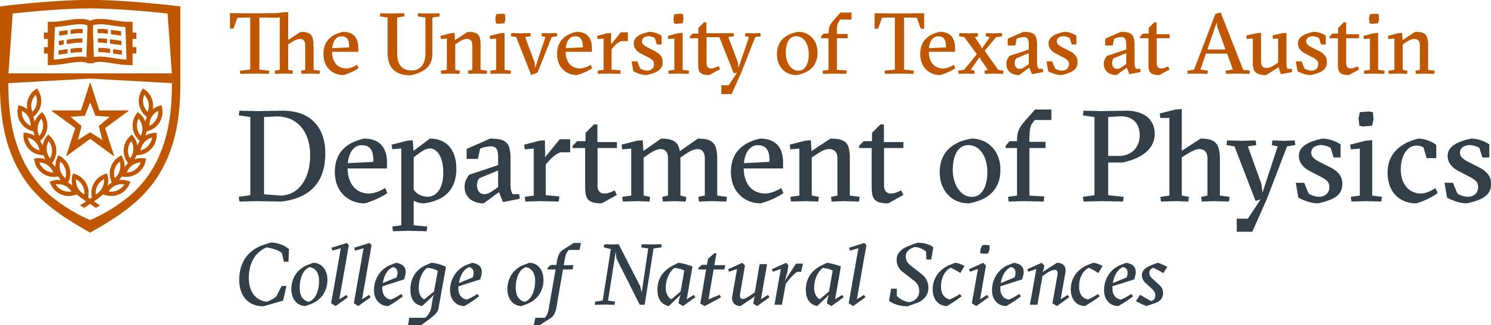
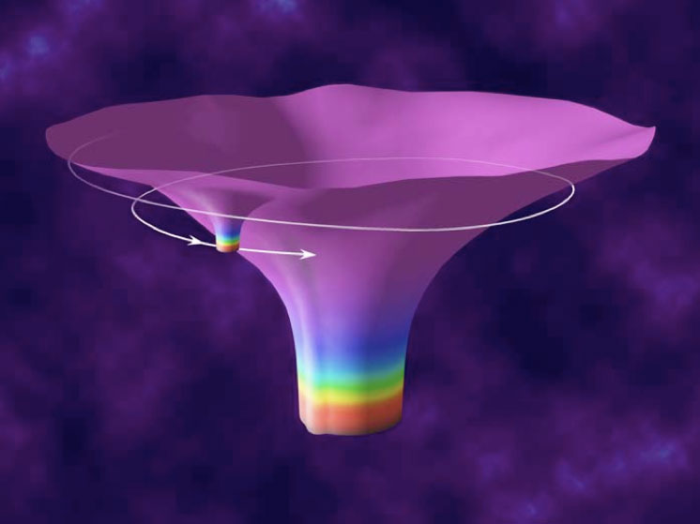






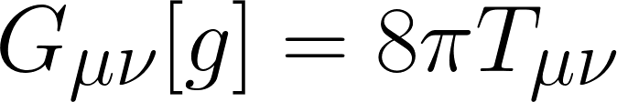


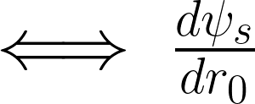


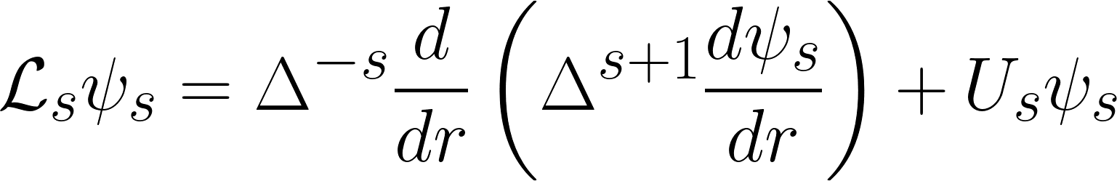
Formally Reducing the Large Aspect Ratio Magnetohydrodynamic Equations
Finny Valorz¹, Supervisor: Joshua Burby¹ ¹Department of Physics, College of Natural Sciences, The University of Texas
Introduction
Figures and Results
Conclusion
Gravitational wave (GW) detections by experimental collaborations like the Laser Interferometer Gravitational-Wave Observatory (LIGO) offer strong evidence in favor of Einstein’s theory of general relativity, as well as an opportunity to test theories of new physics like dark matter. To better understand the information contained within these signals, it is necessary to understand how they are generated. This entails developing mathematical and computational methods to reproduce waveforms from Einstein’s field equations (EFEs). Currently, more complicated systems can only be simulated numerically. In the case of extreme mass ratio binaries however, expansions in a small parameter allow the use of analytical techniques to a very good approximation.
Specifically, black hole perturbation theory (BHPT) is a framework for understanding successive corrections to a general solution of the EFEs. These solutions give the metric tensor, which describes spacetime curvature. In this ongoing research, we make use of BHPT to determine how the amplitude of gravitational waves change as a secondary black hole spirals inward toward a spinning Kerr black hole. To do this, we will solve the spin-weighted Teukolsky equation, a transformed version of the EFEs, whose solution describes the changing curvature of spacetime.
Research Goal
In this ongoing project, we calculate the derivative of Teukolsky curvature scalars with respect to secondary black hole radius. These quantities are already known to second order in Schwarzschild, but only first order in Kerr.
The diagram above depicts the spiraling orbit of a black hole of mass m around a larger, spinning black hole of mass M. As a result of the acceleration these tremendous masses undergo in this situation, ripples are created in the fabric of spacetime in the form of gravitational waves. Interferometer detectors like LIGO detect these waves from Earth.
When the secondary black hole is much smaller than the primary, it behaves very much like a point particle. In this approximation, we conveniently write the sources in terms of delta-functions, which together with the methods of BHPT, allow us to solve Teukolsky’s equations much more directly. The unabbreviated form of the Teukolsky operators and sources are much too complicated to work with directly, so we perform our computations on Mathematica.
Methods
My contribution to this project includes implementing Teukolsky sources for various spin weights in Mathematica, as well as solving the Teukolsky equation given these sources.
As we wrap up this project, Leanne and I will apply similar methods to obtain solutions to the derivative of Teukolsky’s equation and use them to reconstruct perturbations to the metric.
By advancing our understanding of gravitational waveforms and the information they contain, future researchers will be able to capitalize on the improved accuracy of larger experiments, ultimately enabling fundamental tests of a variety of physical theories.
Below is a compact representation of Einstein’s field equations. This famous relation describes how matter and energy, on the right-hand side are responsible for the phenomenon of curved spacetime which we identify as a gravitational force on the left. This set of ten coupled partial differential equations is extremely difficult to solve, but simplifications can be made.
Acknowledgments
I would like to thank my research mentors, Leanne Durkan and Aaron Zimmerman for giving me the guidance and resources necessary to work on this project. Thank you also to our collaborators in Europe: Benjamin Leather, Sam Dolan, Barry Wardell, and Chris Kavanaugh.
The solutions to the Teukolsky equation describe several properties of the gravitational waves generated by binary black hole systems. Through a process known as metric reconstruction, these solutions yield the same information as the metric that appears in Einstein’s famous field equations.
In this project, we are particularly interested in the change in one such property, namely the amplitude. To obtain this, we seek the derivative of Teukolsky’s solutions in terms of the radius of orbit.
References
S. R. Dolan, L. Durkan, C. Kavanagh, and B. Wardell, “Metric perturbations of Kerr
space-time in Lorenz gauge: Circular equatorial orbits”, (2023).
A. Pound and B. Wardell, “Black hole perturbation theory and gravitational self-
force”, (2021).
Shown above is the Teukolsky equation, whose solutions isolate separate aspects of spacetime curvature. For a given spin, s, we have a much simpler equation which we can solve using BHPT.

